Slide 1
Read to Succeed (R2S)
Overview
Notes:
Act 284, Read to Succeed legislation, was created in 2015 to address literacy performance in South Carolina and put in place a comprehensive system of support to ensure SC students graduate on time with the literacy skills they need to be successful in college, careers and citizenship. Act 284 provides for a strong assessment and intervention system for students kindergarten through twelfth grade with a goal of all students becoming proficient readers by the end of third grade.

Slide 2
Purpose of R2S
Research shows...
Students who are unable to comprehend grade-level text struggle in all content area courses
Students who enter preschool or kindergarten with low oral language skills and limited print awareness often fail to develop proficiency with reading and comprehension
Students who have difficulty comprehending texts and who don’t receive intervention are the students least likely to graduate
Students reading below grade level at the end of third grade are six times more likely to leave school without a high school diploma

Slide 3
Eight Components of R2S
Reading Plans (state, district, and school)
Interventions
Early Learning and Literacy
Third Grade Retention
Summer Reading Camp
Educator Preparation
Educator Endorsements
Reading Coaches

Slide 4
Reading Plans
State Reading Plan (ed.sc.gov)
-approved by State Board in June 2015
District Reading Plan
-aligned to state plan
-part of district strategic plan
-tied to state reading funds
School Reading Plans
-aligned to district plan
Notes:
Components of Reading Plan
Leadership
Student Achievement/Assessment
Professional Learning Opportunities
Instruction
Intervention
Community Partnerships
Parental Involvement

Slide 5
2. Interventions
ALL students PreK-12 who are not demonstrating grade level proficiency in reading will receive intensive interventions
Classroom teachers must provide interventions within the classroom and document those interventions
Interventions outside of the classroom must be provided by a certified teachers
Notes:
We have a comprehensive Response to Intervention system in Lexington One. We use a universal screening assessment to determine student strengths and opportunities and then provide instruction and intervention based on those opportunities. Students who need support above the core curriculum are provided Tier II and III supports.
The state summative assessment, SC READY, is one data point which can be used but it does not provide evidence for all grade levels. Screening tools help identify students in need of closer monitoring and those in need of further intensive instruction and intervention. Different types of assessment (screening, progress monitoring, diagnostic, formative, and summative) as well as assessment data from a variety of sources (review of information, interviews, observations, and testing) should be used in making decisions about the need for additional intervention.

Slide 6
3. Early Learning and Literacy
All Pre-K and Kindergarten students will be administered a readiness assessment focused on early language and literacy development, mathematical thinking, physical well-being, and social-emotional development
Pre-K - myIGDIs
Kindergarten - Kindergarten Readiness Assessment (KRA)
Assess birth to first day of Kindergarten
Notes:
Focus area of Molly Spearman and Dr. Little
Early intervention is critical
Readiness assessments provide parents or guardians and teachers with information to assess the readiness needs of each student, specifically language and cognitive strengths and weaknesses. This information assists in making instructional decisions.

Slide 7
4. Third Grade Retention
Beginning with the 2017–18 school year, a student must be retained in the third grade if the student fails to demonstrate reading proficiency at the end of the third grade as determined by the state summative reading assessment (SC READY) and does not meet one of several statutory exemptions.
Students who qualify for a good cause exemption may be promoted to fourth grade.
Read to Succeed legislation provides seven considerations for students who may be exempt from mandatory retention and promoted to fourth grade.

Slide 8
What is a good cause exemption?
Read to Succeed legislation provides seven considerations for students who may be exempt from mandatory retention and promoted to fourth grade.
Good cause exemptions include students:
• with limited English proficiency and less than two years of instruction in English as a Second Language (ESOL) program; Updated December 7, 2016 Page 4
• with disabilities whose IEP indicates the use of alternative assessments or alternative reading interventions;
• with disabilities whose IEP or Section 504 Plan reflects that the student has received intensive remediation in reading for more than two years but still does not substantially demonstrate reading proficiency;
• who demonstrate third grade reading proficiency on an alternative assessment approved by the SBE and which teachers may administer following the administration of the state assessment of reading;
• who have received two years of reading intervention and were previously retained;
• who through reading portfolio documentation demonstrate mastery of the state standards in reading equal to at least one level above the lowest achievement level on the state reading assessment; or
• who successfully participate in a Read to Succeed summer reading camp at the conclusion of the third grade year and demonstrate through either a reading portfolio or through a norm-referenced alternative assessment, that their mastery of the state standards in reading is equal to at least one level above the lowest level on the state reading assessment.

Slide 9
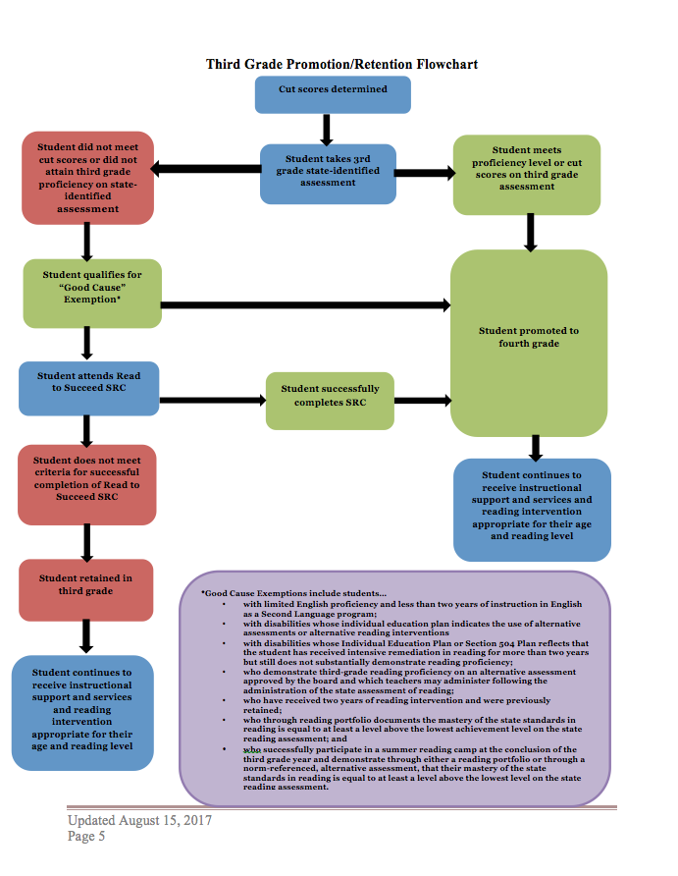
Notes:
Explains the promotion/retention process

Slide 10
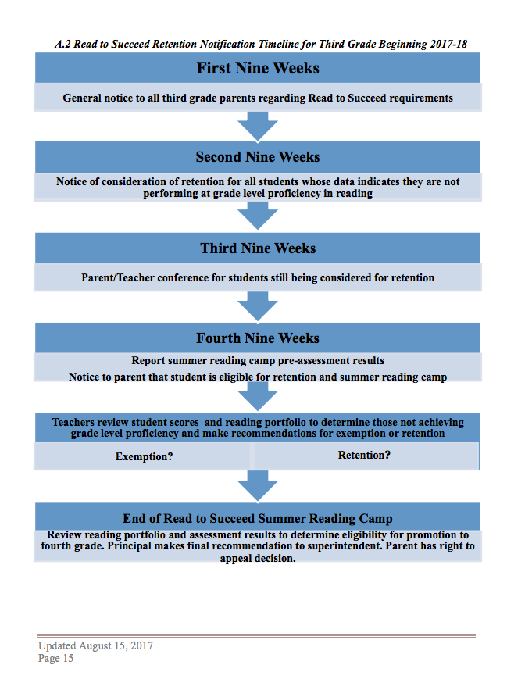
Notes:
Communication timeline
First Nine Weeks - communication done through parent orientation or during first nine weeks conference - if parent doesn’t attend either - teacher must reach out and make them aware of the law

Slide 11
Frequently Asked Questions
Are any third grade students exempt from mandatory retention?
Students who qualify for a good cause exemption may be promoted to fourth grade.
What if a student meets one of the good cause exemptions and is still not reading on grade level?
Regardless of whether a student is promoted or retained, the student shall continue to receive instructional support and services and reading intervention appropriate for their age and reading level.
Must every third grade student have reading portfolio documentation?
Although it is best practice for all students to have reading portfolio documentation, only those third grade students not demonstrating grade-level reading proficiency must have reading portfolio documentation to be considered for a good cause exemption and promotion to fourth grade. Every child in Lexington One in grades Kindergarten through Fifth Grade has a Literacy Collection Folder that follows them from grade to grade.
What services and support are provided to students who are retained due to failing to demonstrate reading proficiency at the end of third grade?
Section 59-155-150 (D) of Act 284 states, “Retained students must be provided intensive instructional services and support, including a minimum of ninety minutes of daily reading and writing instruction, supplemental text-based instruction, and other strategies prescribed by the school district. These strategies may include, but are not limited to, instruction directly focused on improving the student’s individual reading proficiency skills through small group instruction, reduced teacher-student ratios, more frequent student progress monitoring, tutoring or mentoring, transition classes containing students in multiple grade spans, and extended school day, week, or year reading support.”

Slide 12
5. Summer Reading Camp
SRCs are educational programs offered in the summer by each local school district or consortia of school districts for students who are unable to comprehend grade-level texts and who qualify for mandatory retention.
The purpose of a SRC is to provide students who are significantly below third-grade reading proficiency with the opportunity to receive additional quality, intensive instructional services, and support.
Any student in third grade who substantially fails to demonstrate grade-level reading proficiency by the end of the school year must be offered the opportunity to attend a SRC at no cost to the parent or guardian. School transportation shall be provided. The parent or guardian of identified students makes the final decision regarding the student’s participation in SRC. If a parent opts their student out, the mandatory retention requirement applies.

Slide 13
6. Educator Preparation
Beginning the fall semester of 2016-2017, students entering teacher education programs at state institutes of higher education must complete the approved course sequence in literacy to ensure that teacher candidates grasp the theory, research, and practices that support and guide the teaching of reading.
All South Carolina teacher preparation programs have had coursework approved to ensure that teacher candidates graduating from their programs will possess the knowledge and skills to effectively assist children in becoming proficient readers.
Notes:
Those beginning 2015-16

Slide 14
7. Educator Endorsements
Beginning with the 2015-16 school year, South Carolina teachers must complete professional development or coursework related to literacy to earn either the Read to Succeed (R2S) Literacy Teacher endorsement or requirement, depending on their certification area(s).
Educators will have 10 years or two renewal periods to complete the required coursework or professional development for the Read to Succeed endorsement, beginning with their next renewal period. The coursework or professional development may be used for license renewal.
Notes:
Who
What is required
They have time

Slide 15
8. Literacy Coaches
State-funded positions
School-based reading/literacy coaches are employed in each Lexington One elementary school.
They serve as job-embedded, stable resources for professional learning opportunities in schools to generate improvement in reading and literacy instruction.
They support classroom teachers with increasing student reading achievement by analyzing assessment data to determine appropriate instruction and when needed, intensive intervention.

Slide 16
Questions

