Slide 1
Third Reading
Lakeside Middle Attendance Lines
February 15, 2022

Slide 2
New Attendance Lines Rationale
Use facilities efficiently
Minimize the division of subdivisions
Allow future student growth in permanent facilities
Consider transportation patterns for efficient and safe student transportation
Utilize natural and major road boundaries where possible
Balance student enrollment between Lakeside Middle (former Lexington Middle) and Meadow Glen Middle

Slide 3
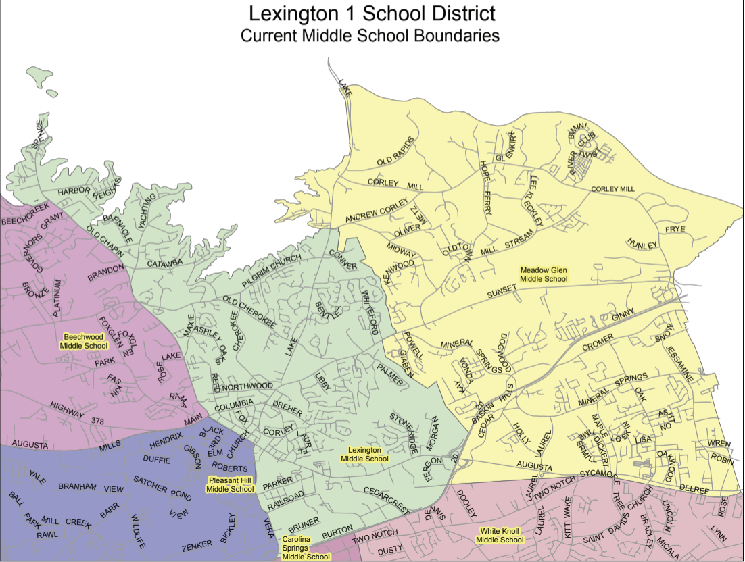
Current LMS/MGMS Attendance Lines
1027
616

Slide 4
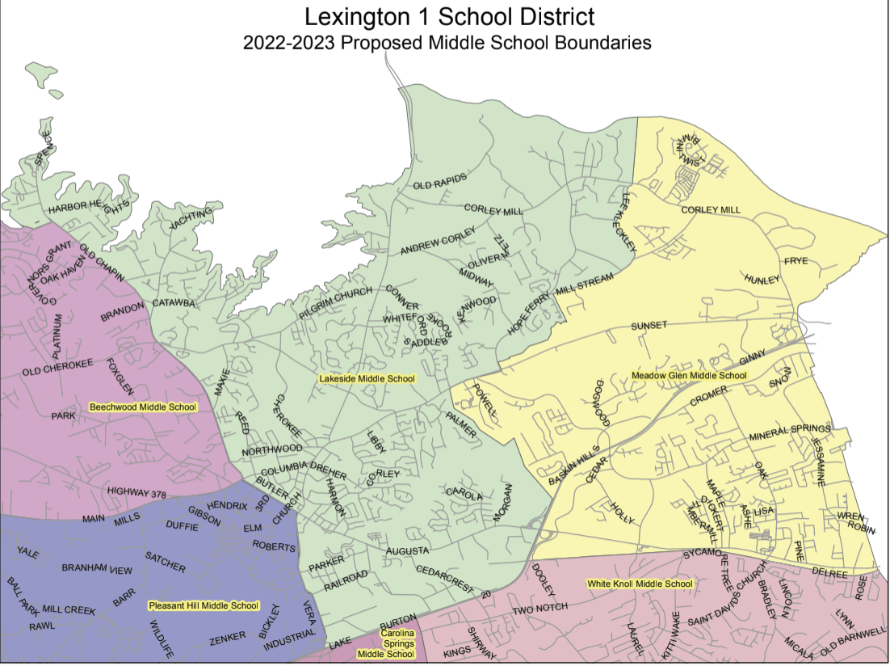
Proposed LMS/MGMS Attendance Lines
826
852

Slide 5
Elementary Feeder Patterns
Lakeside Middle - Portions of Lexington Elementary, New Providence Elementary and Midway Elementary
Meadow Glen Middle - Meadow Glen Elementary and portions of Midway Elementary and Oak Grove Elementary

Slide 6
High School Feeder Patterns
Lakeside Middle - River Bluff High School
Meadow Glen Middle - River Bluff High School

Slide 7
Grandfathering Options for Rising Eighth-Graders
If the new attendance lines show that a current seventh-grade student would be rezoned, that student may elect to stay at his/her current school for his/her eighth-grade year.
Parents/Guardians must provide transportation to and from school. No special bus routes will be available.

Slide 8
Immersion
Chinese immersion will remain at Meadow Glen Middle School
French immersion will be relocated to Lakeside Middle School
8th grade French immersion will be located at Meadow Glen Middle School for next year

Slide 9
Key Dates
First Reading: Board Meeting – 12/14/2021
Public Meetings (6:00 p.m.)
Lexington Middle School – 1/10/2022
Meadow Glen Middle School – 1/12/2022
Second Reading: Board Meeting – 1/18/2022
Third Reading: Board Meeting – 2/15/2022

Slide 10
Proposed Lines School Locator Link
https://app.guidek12.com/lexington1sc/school_search/2022/

Slide 11
Discussion

