Slide 1
Student Isolation and Quarantine Update
Amy A. Wood, BSN, RN
Nursing and Health Services Director

Slide 2
Isolation
Full isolation is 10 days from symptom onset (or date test collected, if asymptomatic)
Isolation may end after 5 days* if:
No symptoms on day 5, and
No fever for at least 24 hours, without the use of fever-reducing medicine, and
Wear mask through day 10
*Students participating in athletics/activities where forced expiration produces increased respiratory
droplets in the surroundings, including shouting, singing, physical exertion, etc. may not return to those
activities until after 10 days.

Slide 3
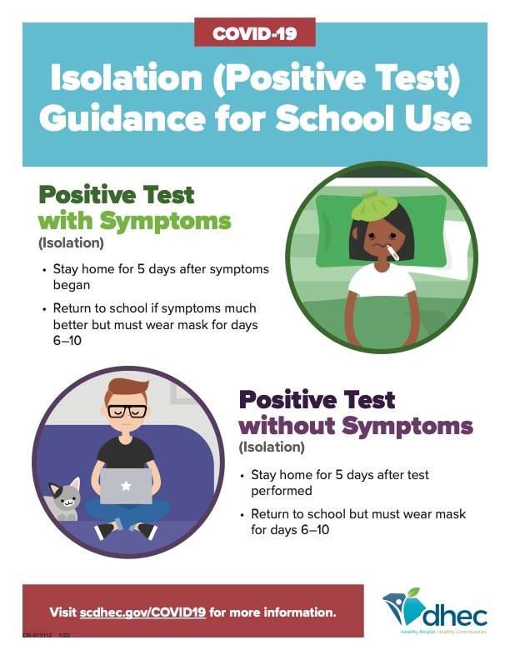

Slide 4
School Close Contact Definition
For student positives in school: Anyone <3 feet for greater than 15 minutes (cumulative) over a 24-hour period, regardless of mask use
For student positives in school: Anyone 3-6 feet for greater than 15 minutes (cumulative) over a 24-hour period who is not masked
For staff positives and athletics/activities: Anyone <6 feet for greater than 15 minutes (cumulative) over a 24-hour period, regardless of mask use

Slide 5
Close contacts Exempt from Quarantine
Students 5-17 yrs old who are fully vaccinated
Completed both doses of primary vaccination series + 14 days
Students 18+ yrs old who are maximally vaccinated
Completed primary vaccination series + booster, if eligible
Students who have tested positive for COVID-19 (antigen or PCR) within 90 days of exposure
May continue to attend school and school-sponsored events, but must wear mask for 10 days after last exposure

Slide 6
Close contacts Not exempt from Quarantine
Full quarantine is 10 days from date of last contact
Quarantine may end after 5 days*, if:
No symptoms during daily monitoring at home, and
Wear a mask through day 10
* Students participating in athletics/activities where forced expiration produces increased
respiratory droplets in the surroundings, including shouting, singing, physical exertion, etc.
must provide a negative test no earlier than day 5 in order to return to those activities.

Slide 7
Close contacts Not exempt from Quarantine
Addition of Test To Stay (TTS) option for families
Test To Stay (TTS), if eligible, may attend school if:
No symptoms during daily monitoring at home, and
Viral test (antigen or PCR) between 5-7 days after last exposure
Wear a mask through day 10

Slide 8
Household Contacts
Subcategory of close contact
Quarantine length is dependent on the ability of the positive case(s) to separate away from the student during isolation period
Students who are HHC where the positive case(s) are unable to separate away are not eligible for TTS
Students who are HHC where the positive case(s) are unable to separate away must remain home through the positive case(s) isolation period + the duration of quarantine

Slide 9
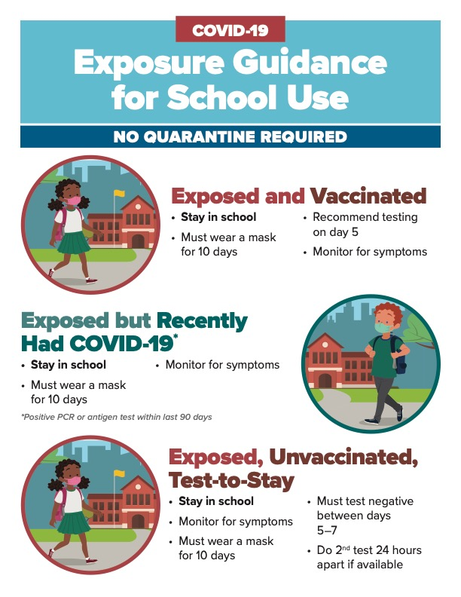

Slide 10
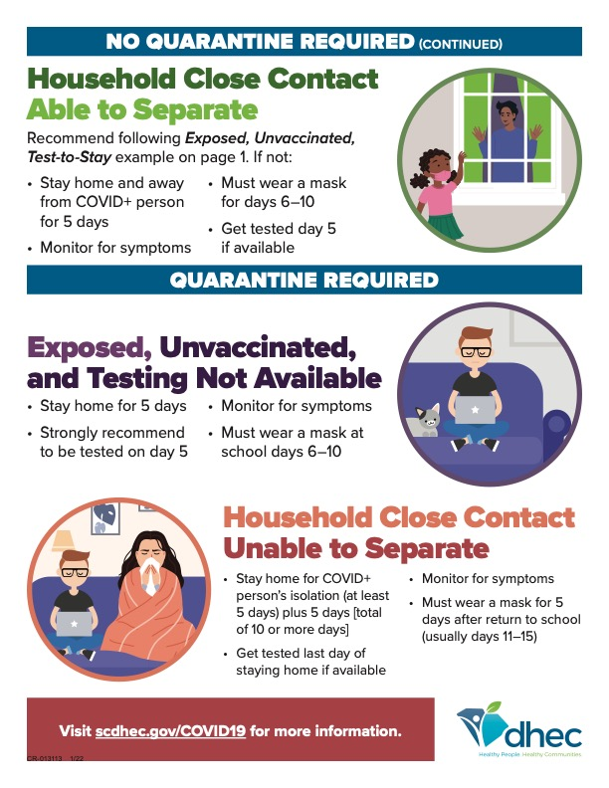

Slide 11
TTS: What to expect
TTS will be managed by our Contact Investigators
Families reporting student exposures outside of school will have the opportunity to opt-in to TTS as part of the district’s COVID report form
Families of students identified as school close contacts will have the opportunity to opt-in to TTS in the notification letter sent via SchoolMessenger
We will accept home test results (must be accompanied by the completed DHEC Attestation Form)
If results are not received by the end of day 7, the student must quarantine at home for days 8-10

